Slide 1
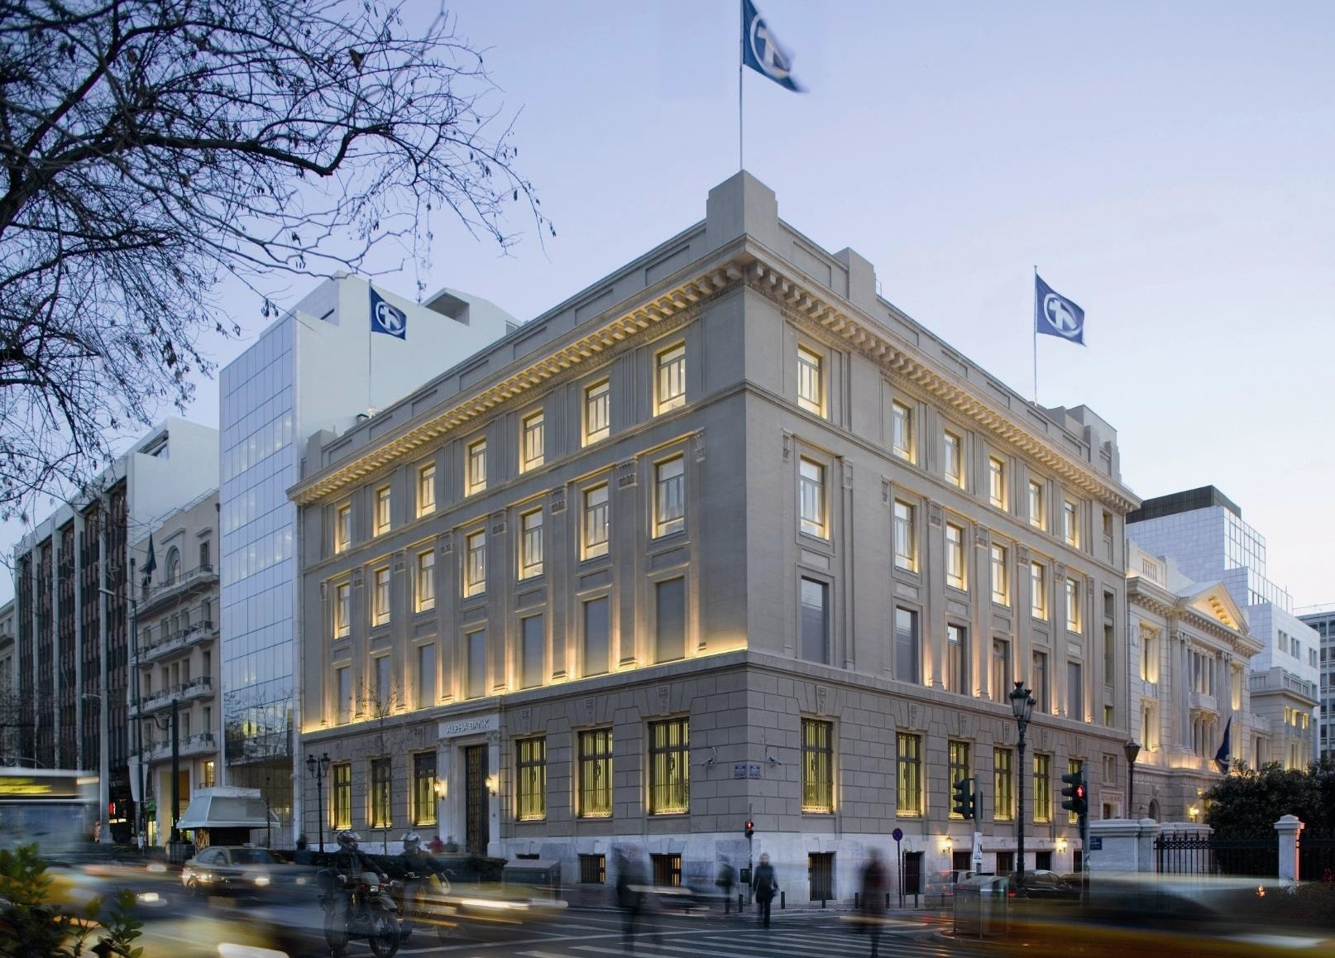
Assignment
February 2023

Slide 2
Customer Churn
1. Scope & Objectives
2. Key Findings
3. ML Process
4. Prediction Results
5. Next Steps

Slide 3
Scope & Objectives
Age
Leverage customer data of last 3 months in order to understand reasons that drive customers to move away from the bank.
Identify customers that are likely to churn in the next 3 months.
Replace existing business rule process with an AI one, capable of identifying patterns in customer behavior and preferences
Process will run monthly and estimate churn likelihood by customer.
Benefits
Identify pain points that affect customer experience.
Personalized and efficient targeting.
Make most of existing resources by focusing on top X% of customers with highest churn probability.
Monthly re-run of process will allow campaign management and CX team a sufficient time buffer to reach out to potential churners.
Gender
Balance
Credit Card
Geography
Loan
Tenure
Product #
Income

Slide 4
Customer Churn
1. Scope & Objectives
2. Key Findings
3. ML Process
4. Prediction Results
5. Next Steps

Slide 5
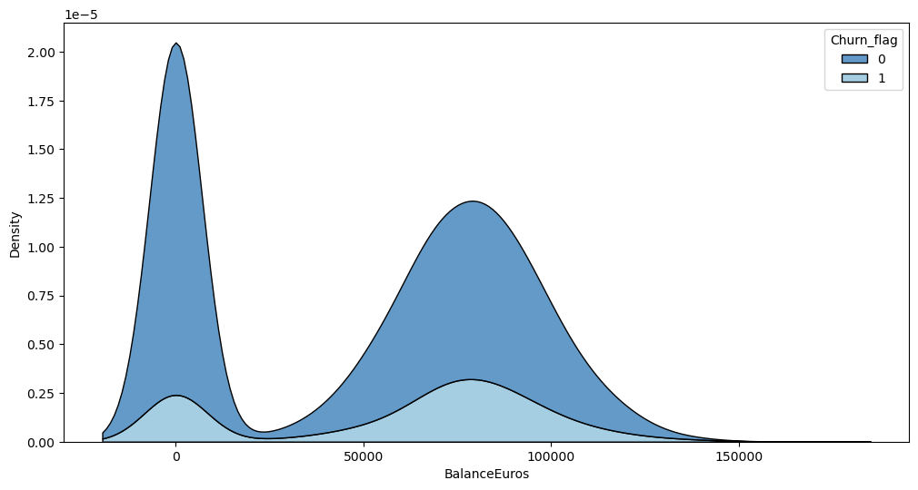
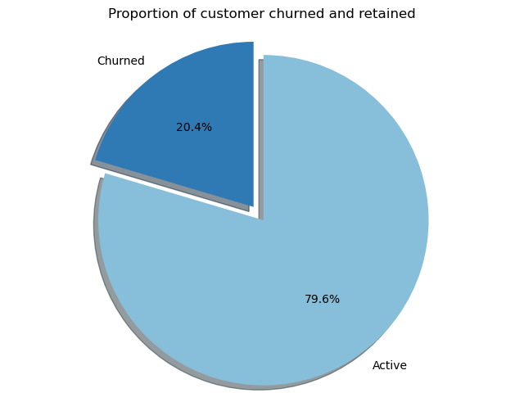
Key Findings - Customer Base
There roughly 10.000 customers that comprise the Banks customer base and used for the analysis
Initial analysis identified a handful of customers whose information are duplicated in the data. Those customers have been entirely excluded from further analysis.
From the above number, 20.4% has been found as churners in the next three months.
It has been identified that churners tend to have a high/er account balance whilst non churners tend to the middle end (median 75K vs 60K)

Slide 6
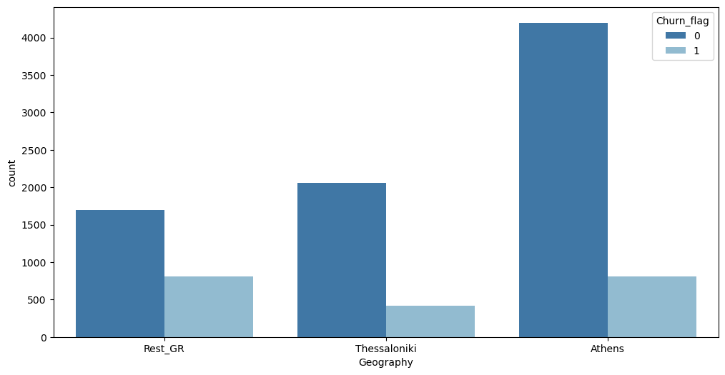
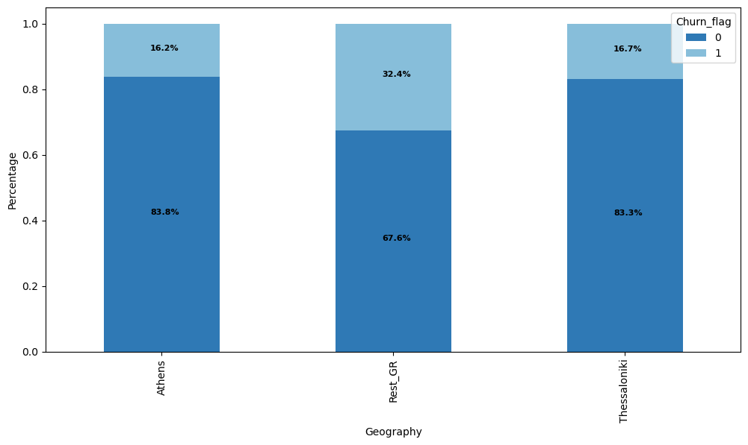
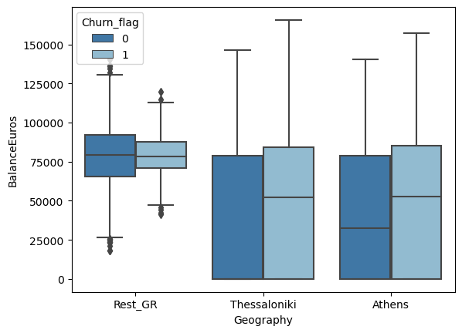
Key Findings - Geography
Bank is operating in three distinct areas: Athens -Thessaloniki - Rest of Greece
Athens is by far the area segment where most account holders inhabit with that number exceeding 4.000 accounts.
In contrast, churn percentage reaches almost double figures in Rest of Greece segment compared to its other two counterparts (~32% against ~16%)
Interesting fact is that account balance of churners in Athens and/or Thessaloniki is higher for churners compared to non-churners.

Slide 7
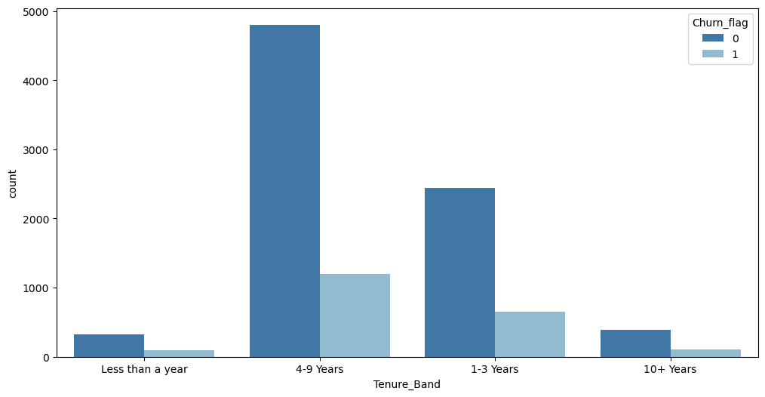
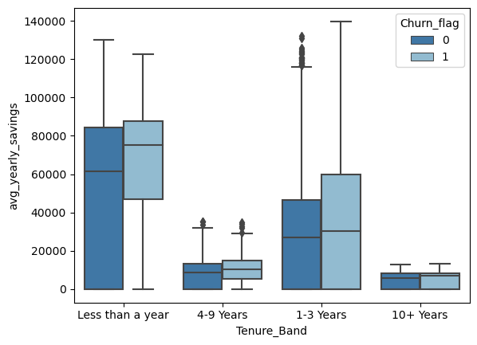
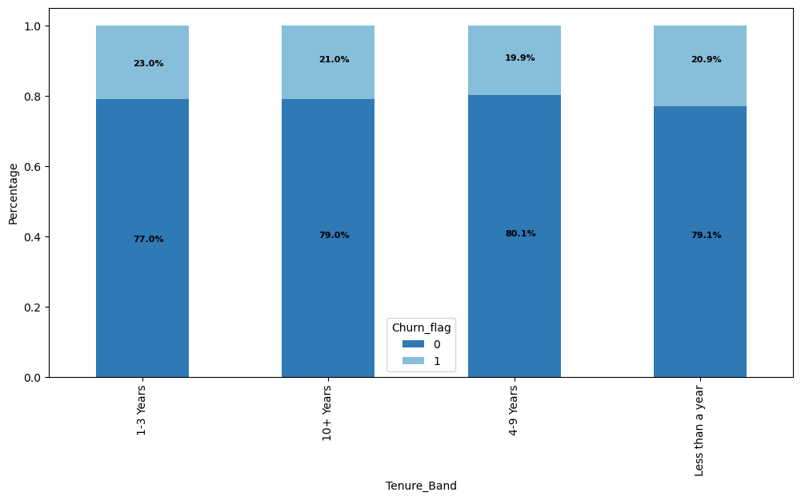
Key Findings - Tenure
Tenure of customers is broken down in four distinct size bins:
Vast majority of account holders have a tenure of 4-9 years.
No groundbreaking differences between churners and non churners apart from a slight % increase in 1-3 group.
Regardless, accounts with <1 year of tenure have a high average annual saving amount.
Accounts with less than a year of life
Accounts with 1-3 years
Accounts with 4-9 years
Accounts with 10+ years

Slide 8
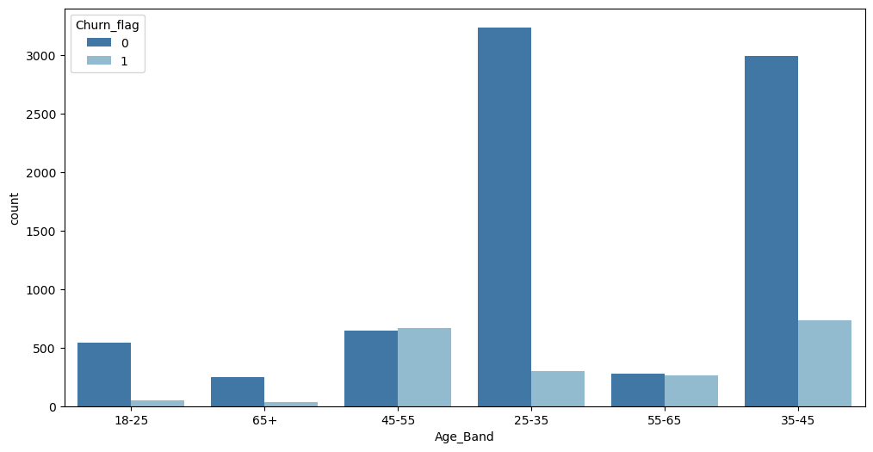
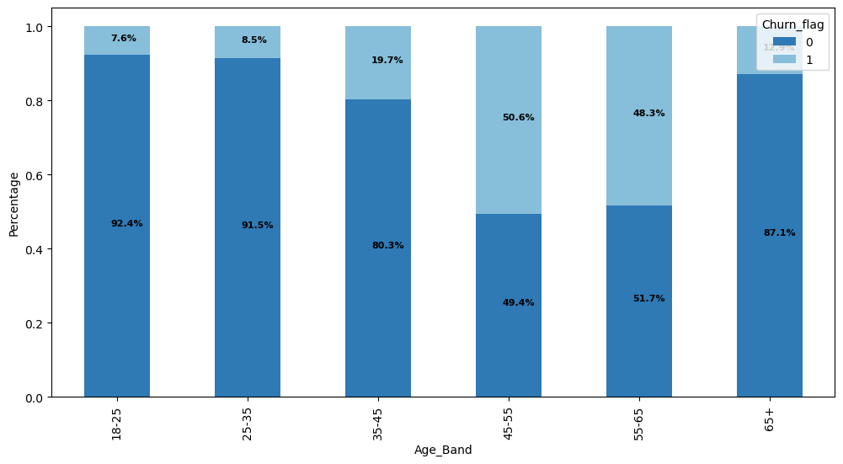
Key Findings - Age
Base of customers is comprised of individuals with ages ranging from 18 to 65+.
The youngest segment has the lowest churn rate, 7.6% followed by 65+.
Increased churn rate with age, linearly at a point.
Half of middle aged customers (45-55 years old) seem to have churned.

Slide 9
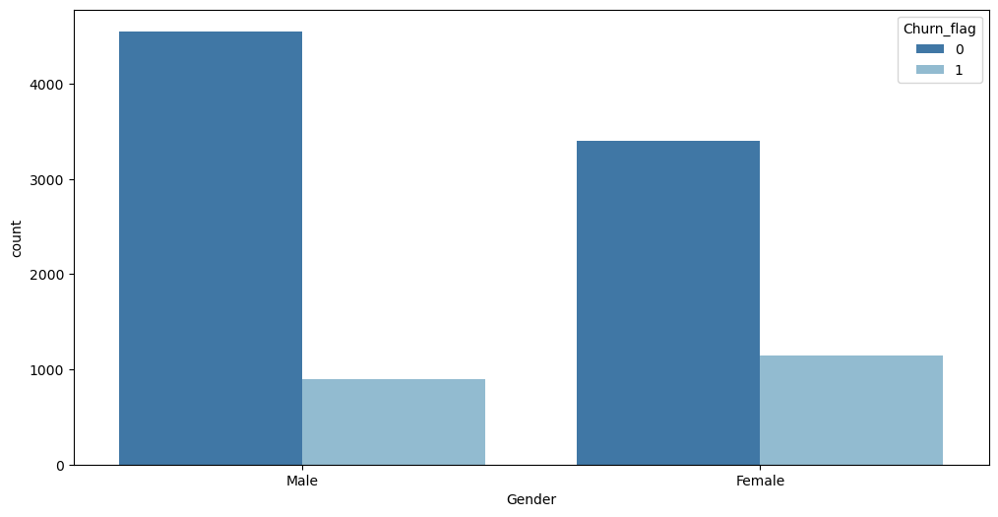
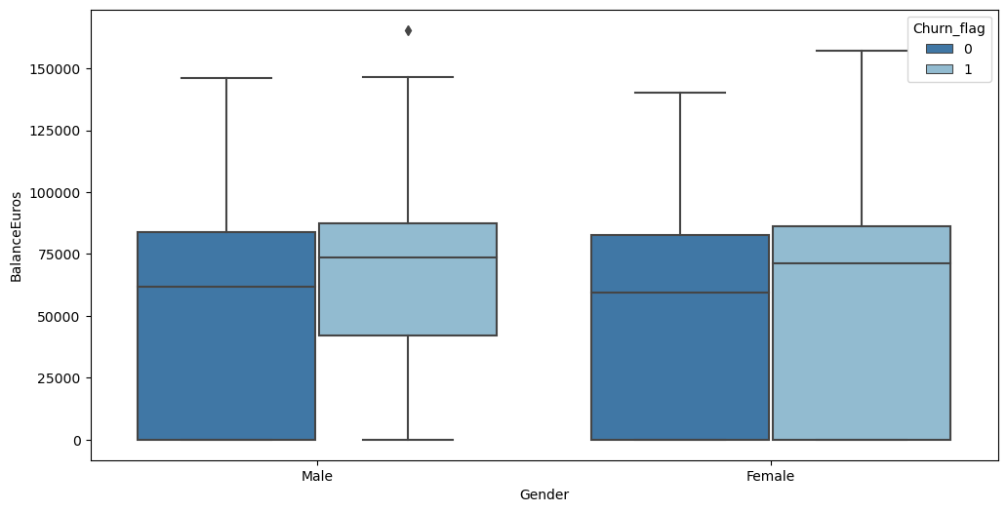
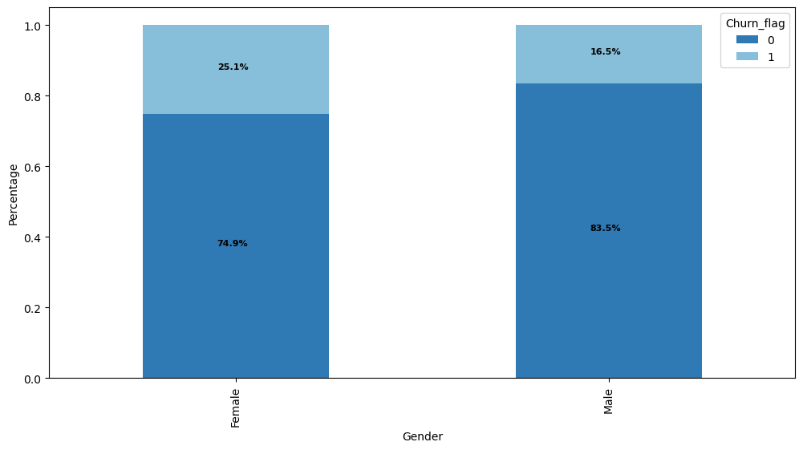
Key Findings - Gender
Slightly higher number of male account numbers against female users.
In contrast, female account holders seem to have a higher tendency to churn reaching ~25%.

Slide 10
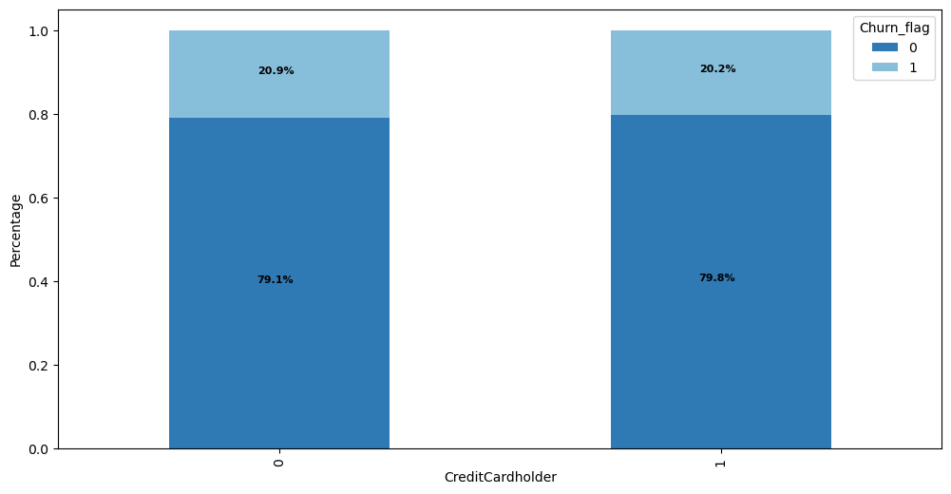
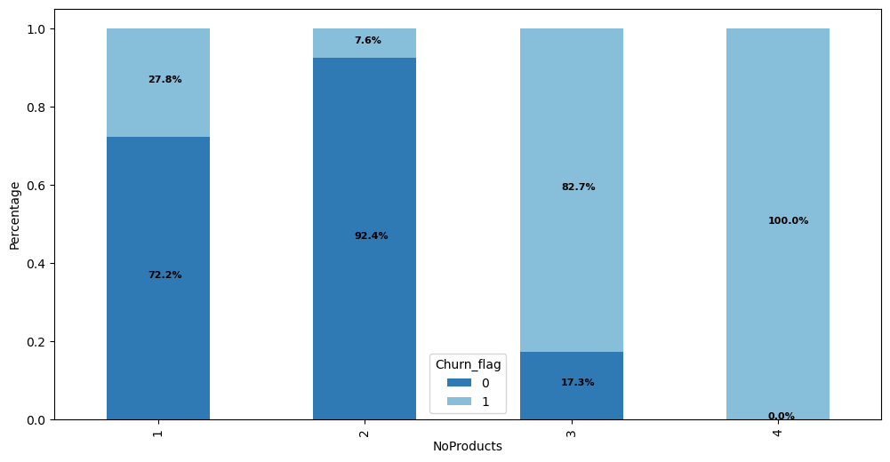
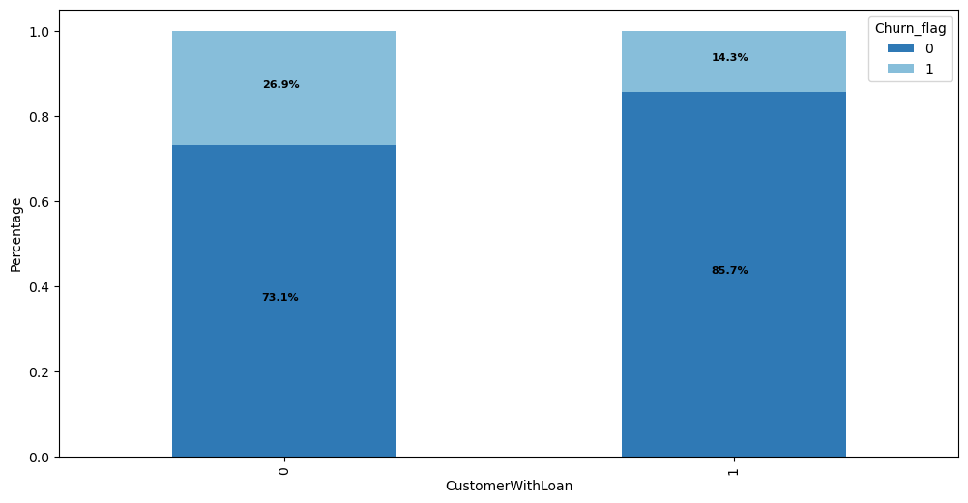
Key Findings - Products & Services
Most account holders have either 1 or 2 products with the bank.
Going deeper, customers with two products show the lowest churn rate whilst those with 3 or 4 are churning entirely.
In those cases where a customer does not have an outstanding loan, churn rate tends to be higher by almost double figures.
The latter is invalidated for customers with a credit card.

Slide 11
Customer Churn
1. Scope & Objectives
2. Key Findings
3. ML Process
4. Prediction Results
5. Next Steps

Slide 12
ML Pipeline
Raw Data
Pre -Processing
Prepared Data
Learning Phase
Test Candidate Model
Deploy
Chosen Model
Raw Data
Data Processing Modules
ML Algorithms
Applications

Slide 13
Customer Churn
1. Scope & Objectives
2. Key Findings
3. ML Process
4. Prediction Results
5. Next Steps

Slide 14
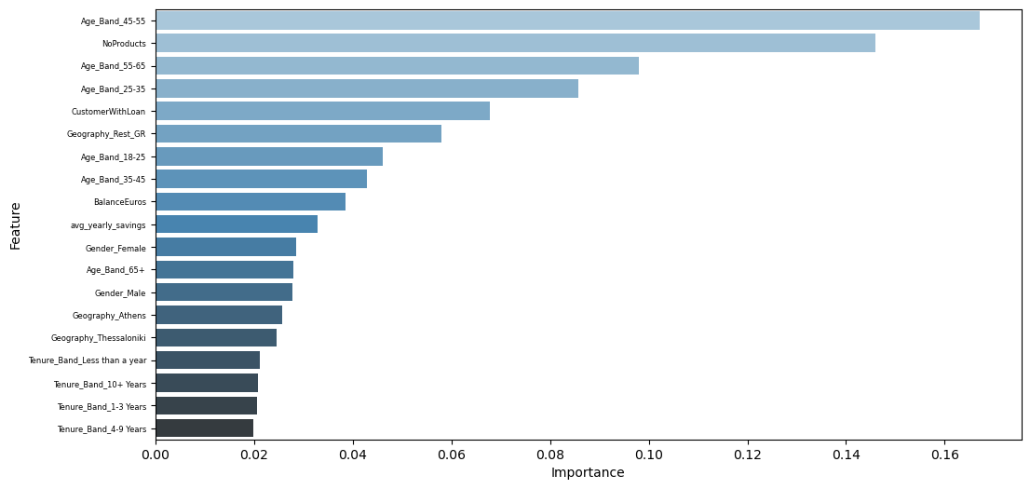
Feature Importance
Age seems to be the most influential case in correct predictions, especially when it concerns people from 45 to 55.
Number of products is also a dimension that plays a significant role.
Similarly, some Bank products, such as existence of a loan, tends to improve our classifier predictions.

Slide 15
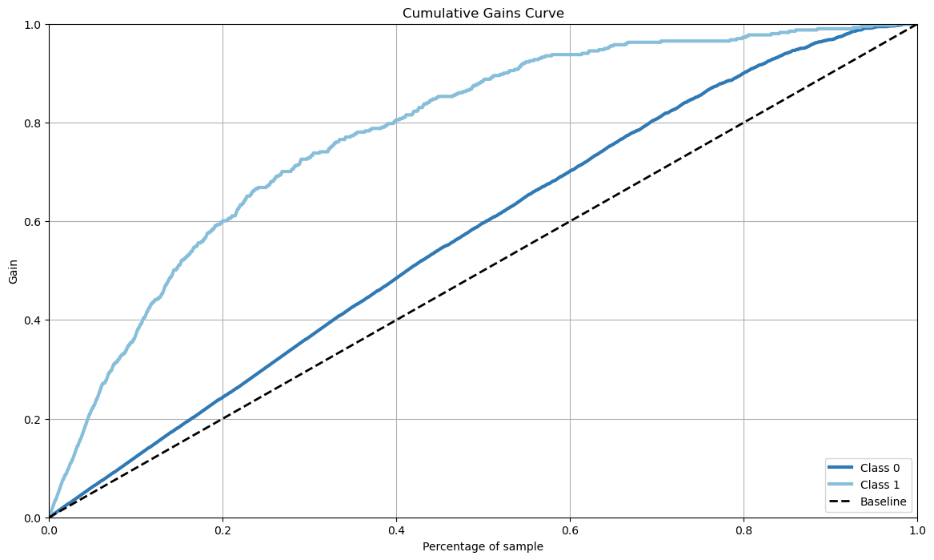
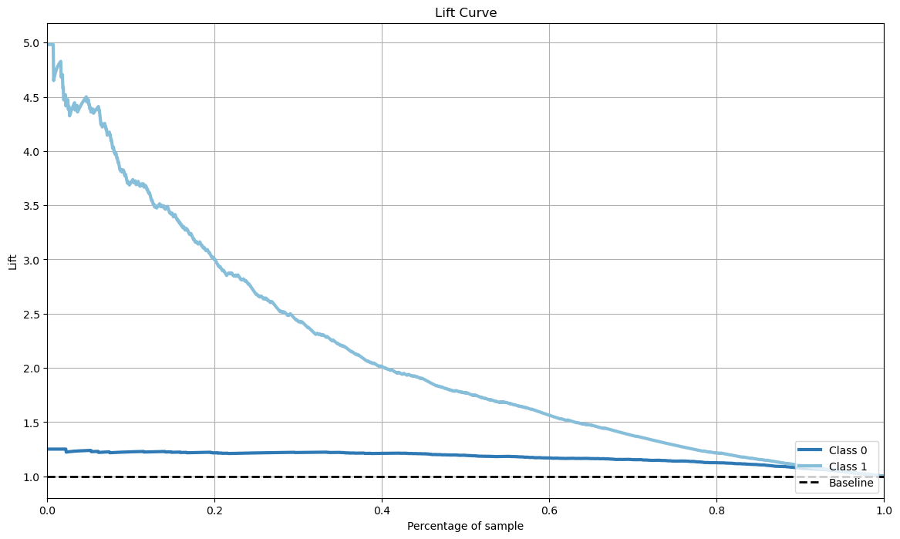
Evaluation
 | Precision | Recall | F1-Score | Support
Active | 0.87 | 0.96 | 0.91 | 1597
Churn | 0.74 | 0.40 | 0.52 | 401
Accuracy |  |  | 0.85 | 1998
Macro avg | 0.80 | 0.68 | 0.72 | 1998
Weighted avg | 0.84 | 0.85 | 0.83 | 1998

Slide 16
Recommendations
Investigate and redefine if necessary loan offerings/processes in order to understand why this factor influences loyalty of customers.
Potential reasons:
Loans with higher interests compared to competition.
Focus on developing geographical areas where churn rate is higher.
Potential reasons:
Stronger presence of competitors when it comes to physical stores on those areas.
Why do so many female users choose to leave the bank?
Potential reasons:
Is it because of bank’s products or maybe even inappropriate behavior on physical stores and/or CC centers?
Customers with higher balance, whose presence is also stronger in middle ages, churn more.
Potential reasons:
Are competitors offering special savings or other benefits plans above an amount threshold hence increasing turnover?

Slide 17
Customer Churn
1. Scope & Objectives
2. Key Findings
3. ML Process
4. Prediction Results
5. Next Steps

Slide 18
Next Steps
Automate data flow and scoring mechanism
4
A/B testing
3
Research and include more features from additional data sources such as:
Account type (savings, payroll etc)
Web/App banking user, # logins, etc
Sentiment analysis on CC inquiries
2
Consult with stakeholders and decide on campaign requirements
1

